Slide 1
Senhe Hao’s Checkers
Something I made so I can get experience with Java’s graphics

Slide 2
What is This?
This is the ancient game checkers remade on a modern day computer. I am completely finished with it and may update it a bit if I need to test out stuff with Java’s graphics. This game is made in Java. I used only standard libraries. I have 3 classes that I use for this game. The rules are the standard checkers rules.

Slide 3
What did I not write?
This quarter, I wrote everything in my code. Some variable names were inspired by other code, but never copied. Everything was hand typed by myself with thoughts from my own brain.

Slide 4
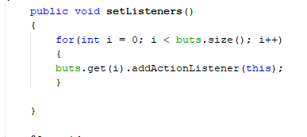
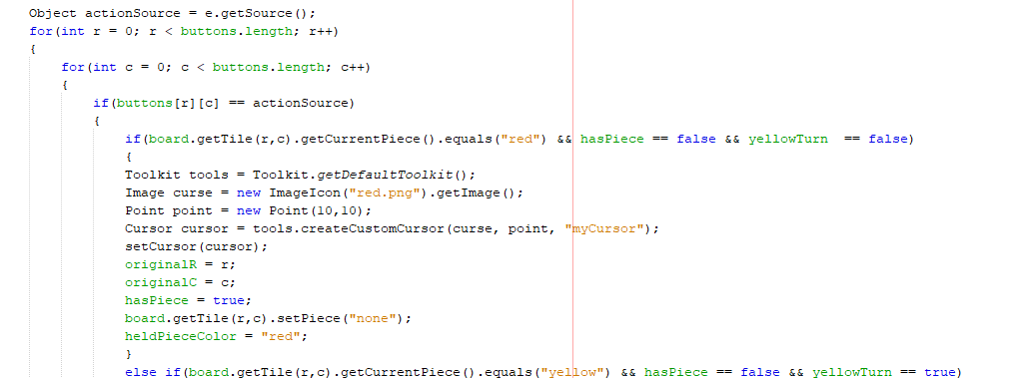
How looping is used in my code
Here is a single loop used to add action listeners to buttons added to the bottom jpanel.
The loop on the bottom is a double loop. This is the most important part of the code, as this is where all the moving pieces and stuff and kept track if and calculated.

Slide 5
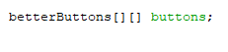
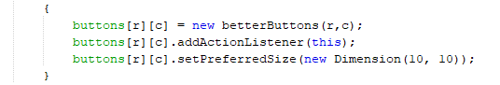
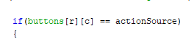
Data Structures in my project
I created an array that stores buttons
I assigned a new button to each button with row and column stored in each button
I access a button on the array using a loop and check is that button is the source for the action.
This data structure stores the buttons on each place in the actual checkerboard, which is quite important as that is almost the entire graphics part.

Slide 6
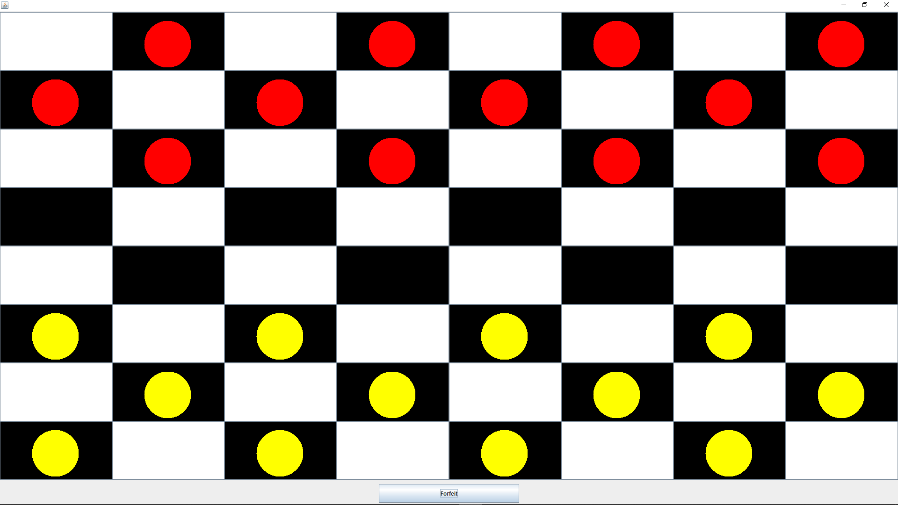
Input and Output
Each one of the squares on the board takes in input along with the button on the bottom and the output is how to squares change such as the checker pieces moving from square to square.

Slide 7
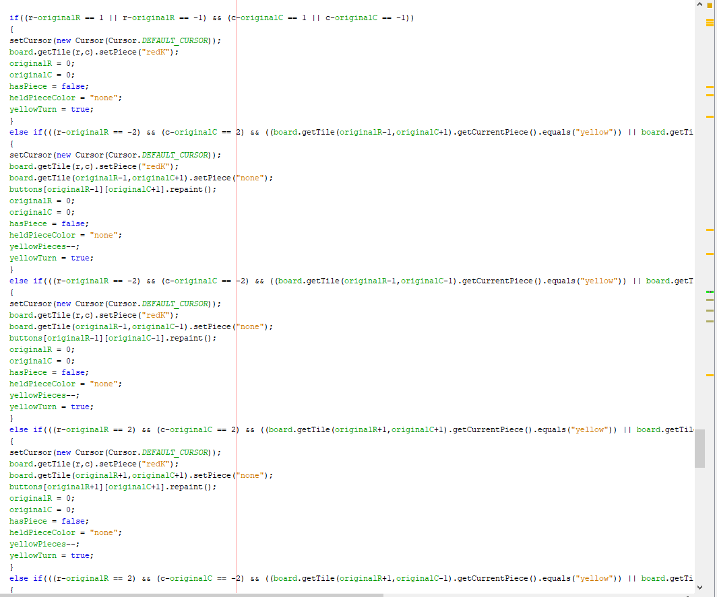
If else if
Here is a long if else if that I use to determine the movement of a checker piece. I get the locations of checkers and use the destination to calculate is that is a legal move. Each type of move is an if else if.

Slide 8
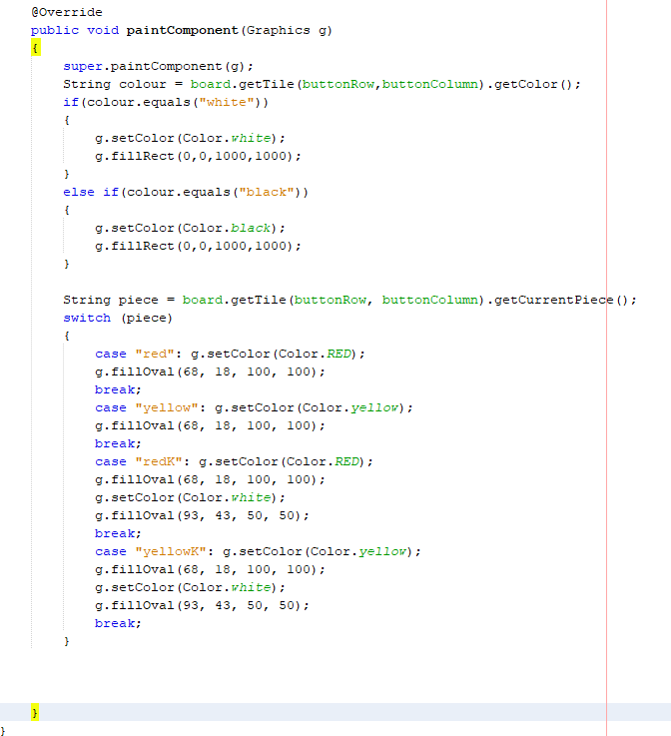
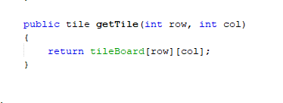
Methods
Here are some methods. The first one is an override of a paintcomponent method that takes in the parameter g and uses it to do graphics stuff. The second one is a method that takes in the row and column and uses it to find the matching tile object stored there and returns it.

Slide 9
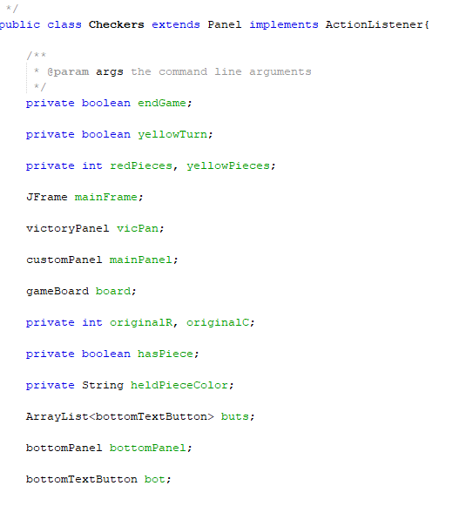
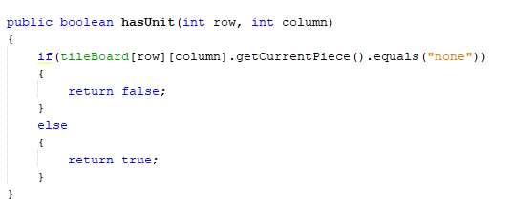
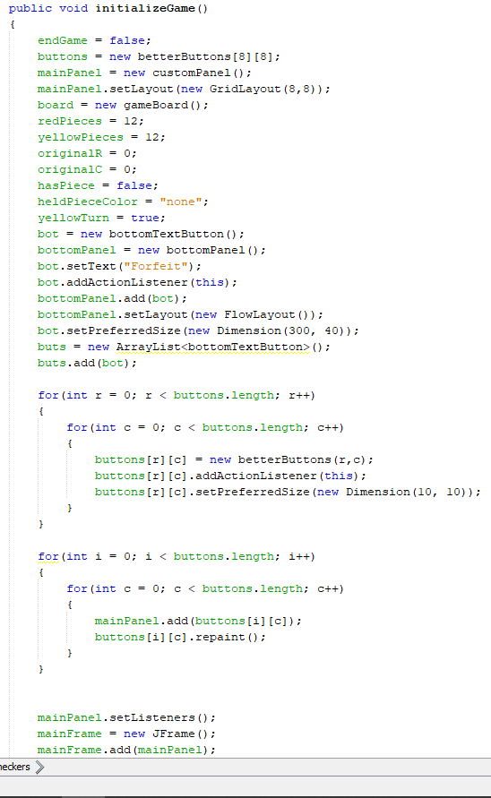
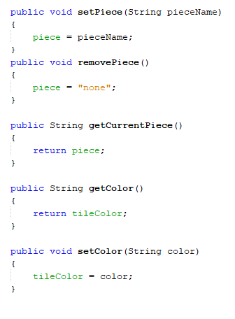
Classes
Here is a class with some instance variables and an initialize method. There are getter and setter methods too and a few non getter setter methods with parameters from a different class. Their purposes should be pretty clear.

Slide 10
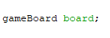
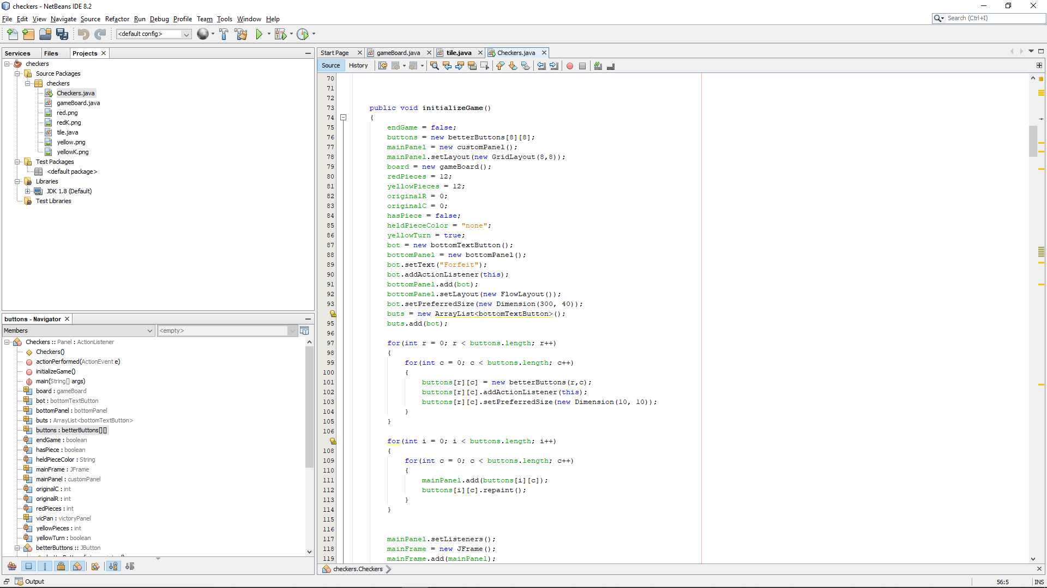
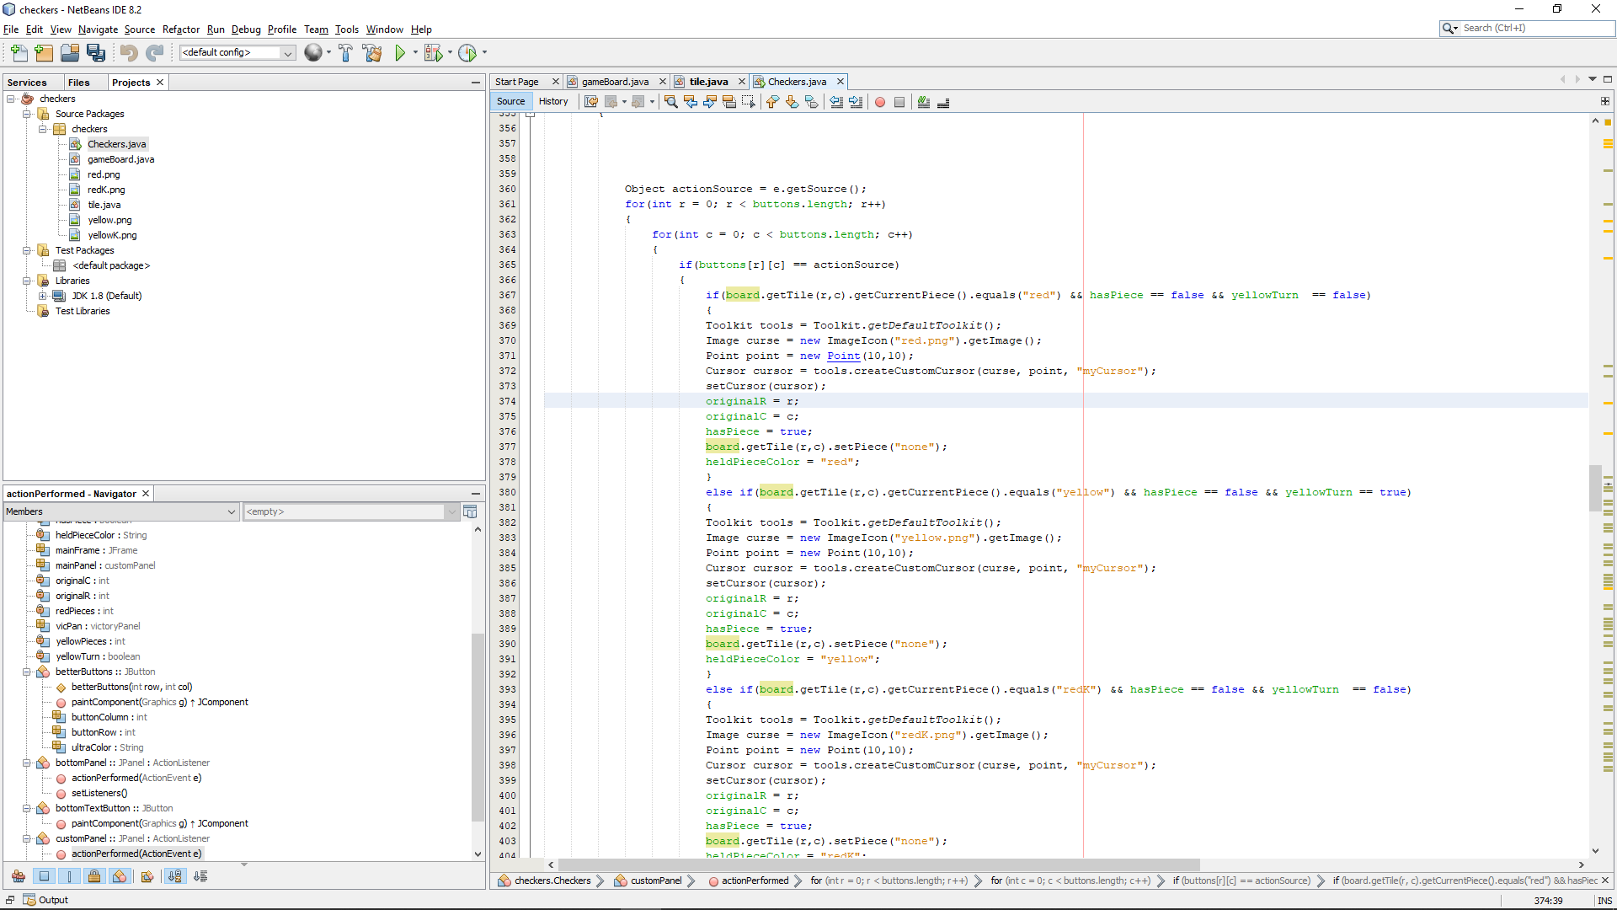
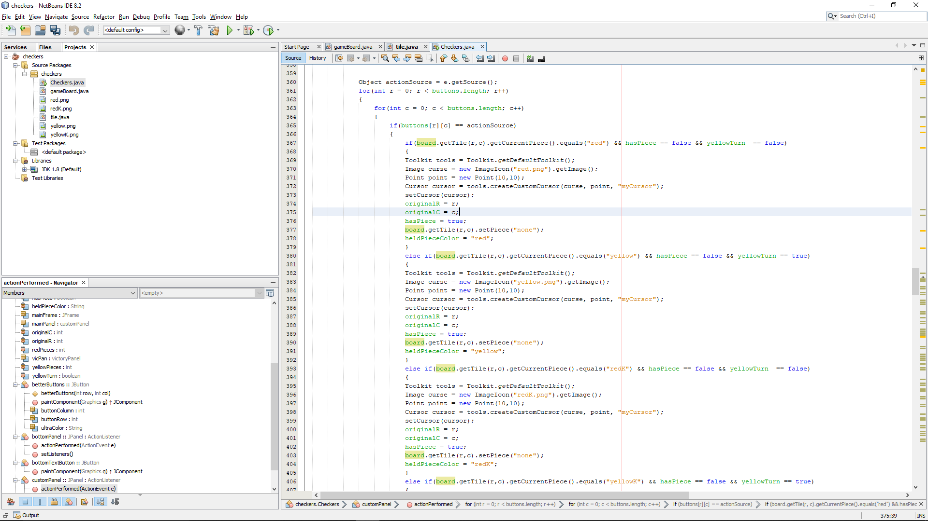
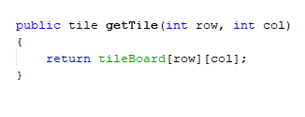
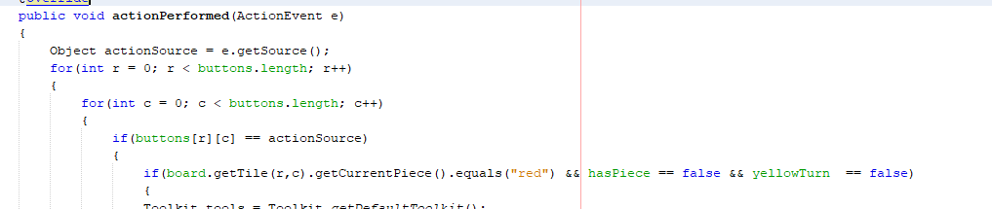
Instance of an object and some calls to methods inside it.
Instance variable of a gameboard object
This calls to a method in the board that gets the corresponding tile to the row and column passed to the method
This method also modifies the piece on a given tile with r and c.
These retrieve an instance tile with a given r and c
This actionperformed method outputs some pretty useful data. It takes in an event and uses it to change the graphical board.

